Slide 1
Unit 4
FIBER OPTICS AND LASER

Slide 2
OPTICAL FIBER
Fibre optics is a technology in which signals are converted from electrical signals to optical signals, transmitted through a thin glass fibre and recovered into electrical signals.
An optical fibre is essentially a waveguide for light. It transmits light pulses and can be used for analog or digital transmission of voice, computer data, video, etc.
An optical fibre is a cylindrical waveguide made of transparent dielectric (glass, plastic), which guides the light waves along its length by total internal reflection.

Slide 3
Advantages of optical fibres vis-a-vis metal wires
Optical fibre has large bandwidth, i.e. it can transmit more data per second.
It is of very low loss. This implies that longer distance communication is possible using the optical fibers.
Carries signal at a much faster rate.
Immune to crosstalk.
Since the data is carried as light, there is no electrical hazard.
Special applications like medical imaging and quantum key distribution are only possible with fiber because they use light and are made of dielectrics.

Slide 4
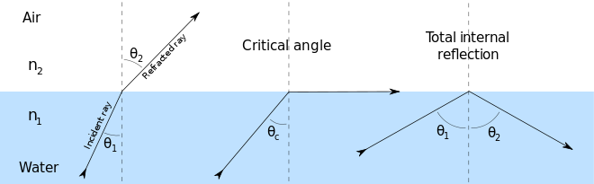
Optical fibers work on the principle of total internal reflection.
The angle of refraction at the interface between two media is governed by Snell’s law
When a ray of light travel from a high to a low refractive index material, it will move away from the normal. i.e. the angle of incidence is smaller than the angle of refracted ray.
The reverse is true for rays travelling from low to high index material. The relation between the incident and refracted angles are related in terms of propagation velocities in the media as SNELL’S LAW

Slide 5

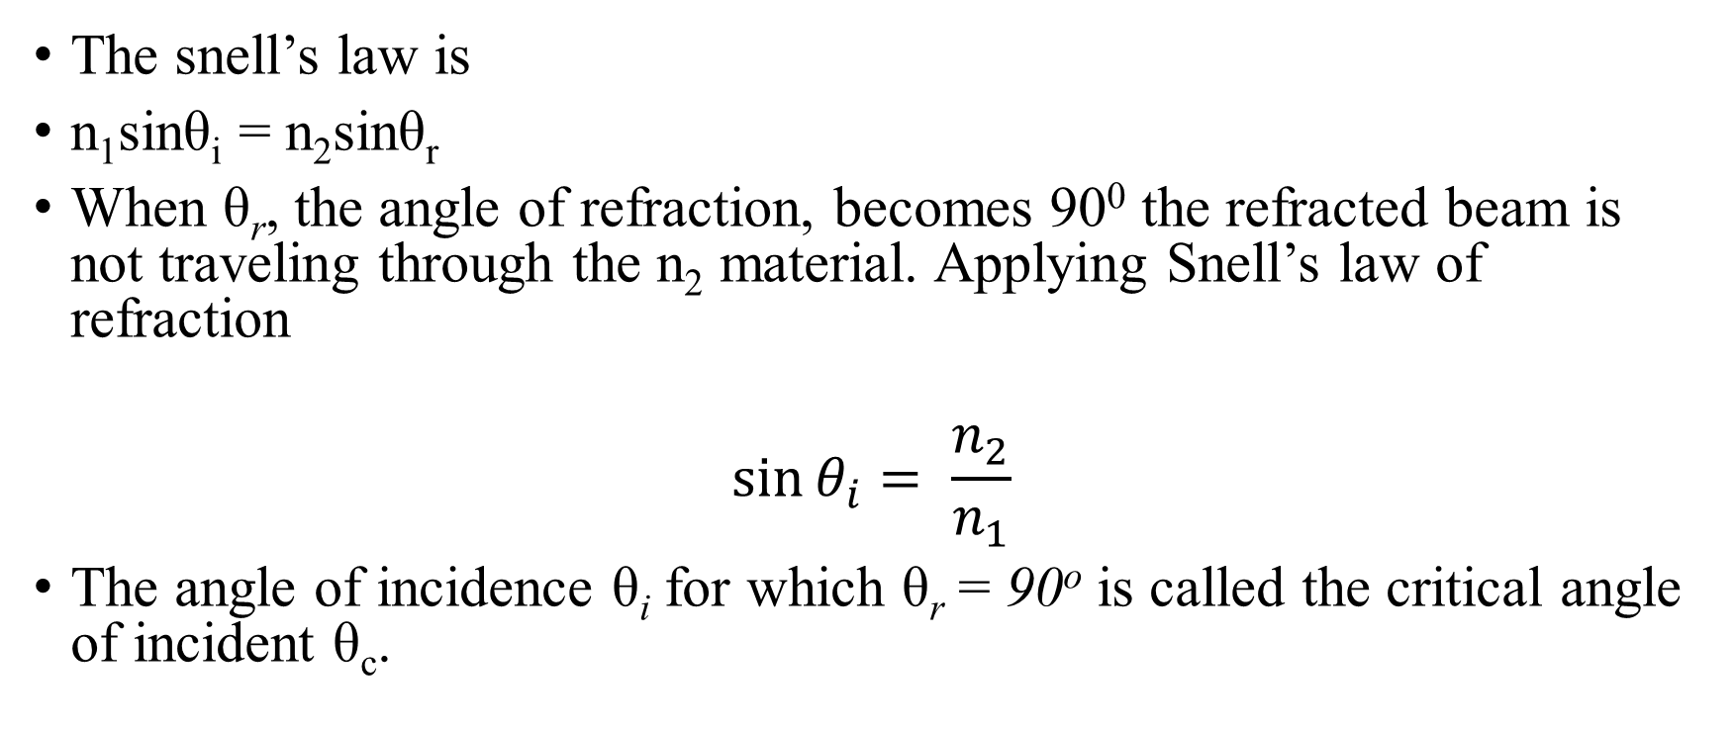
The snell’s law is
n₁sinθ_{i} = n₂sinθ_{r}
When θ_{r}, the angle of refraction, becomes 90⁰ the refracted beam is not traveling through the n₂ material. Applying Snell’s law of refraction
$$\sin{θ_{i}= \frac{n_{2}}{n_{1}}}$$
The angle of incidence θ_{i} for which θ_{r} = 90º is called the critical angle of incident θ_{c}.
$$\sin{θ_{c}= \frac{n_{2}}{n_{1}}}$$

Slide 6
From the above discussion following important conclusions can be drawn:
The light can be restricted to the material with the higher index of refraction if the incident angle is kept above the critical angle.
A sandwich of high index material placed between two slabs of low index material will allow a beam of light to propagate in the high index material with relatively low loss.
This concept is used in constructing fibres for fibre optic communication

Slide 7
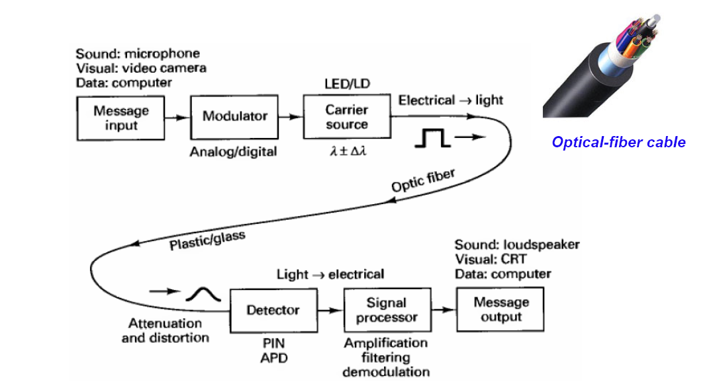

Slide 8
Light source:
Amount of light emitted is proportional to the drive current
Two common types:
LED (Light Emitting Diode)
ILD (Injection Laser Diode)
Source–to-fiber-coupler (similar to a lens):
A mechanical interface to couple the light emitted by the source into the optical fiber
Light detector:
PIN (p-type-intrinsic-n-type)
APD (avalanche photo diode)
Both convert light energy into current

Slide 9
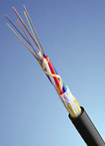
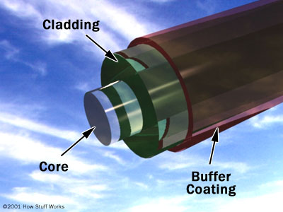
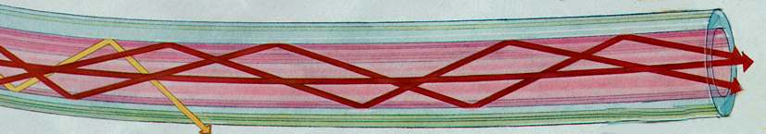
Structure of Optical Fiber
Glass or plastic
cladding
Plastic jacket
Fiber core

Slide 10
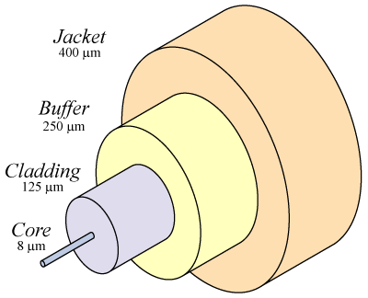
Core
Glass or plastic with a higher index of refraction than the cladding
Carries the signal
Cladding
Glass or plastic with a lower index of refraction than the core
Buffer
Protects the fiber from damage and moisture
Jacket
Holds one or more fibers in a cable

Slide 11
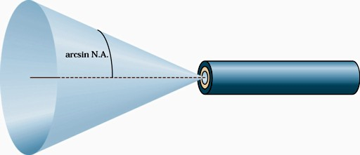
Numerical Aperture
The Numerical Aperture (NA) is a measure of how much light can be collected by an optical system such as an optical fibre or a microscope lens.
The NA is related to the acceptance angle θ_{a}, which indicates the size of a cone of light that can be accepted by the fibre.
The numerical aperture of the fiber is closely related to the critical angle and is often used in the specification for optical fiber and the components that work with it
The numerical aperture is given by the formula:
Where n₁ = refractive index of core
n₂ = refractive index of cladding
n_{a} = refractive index of air (1.00)
NA = n_{a}Sin θ_{a} = (n₁² – n₂²)^{1/2}

Slide 12
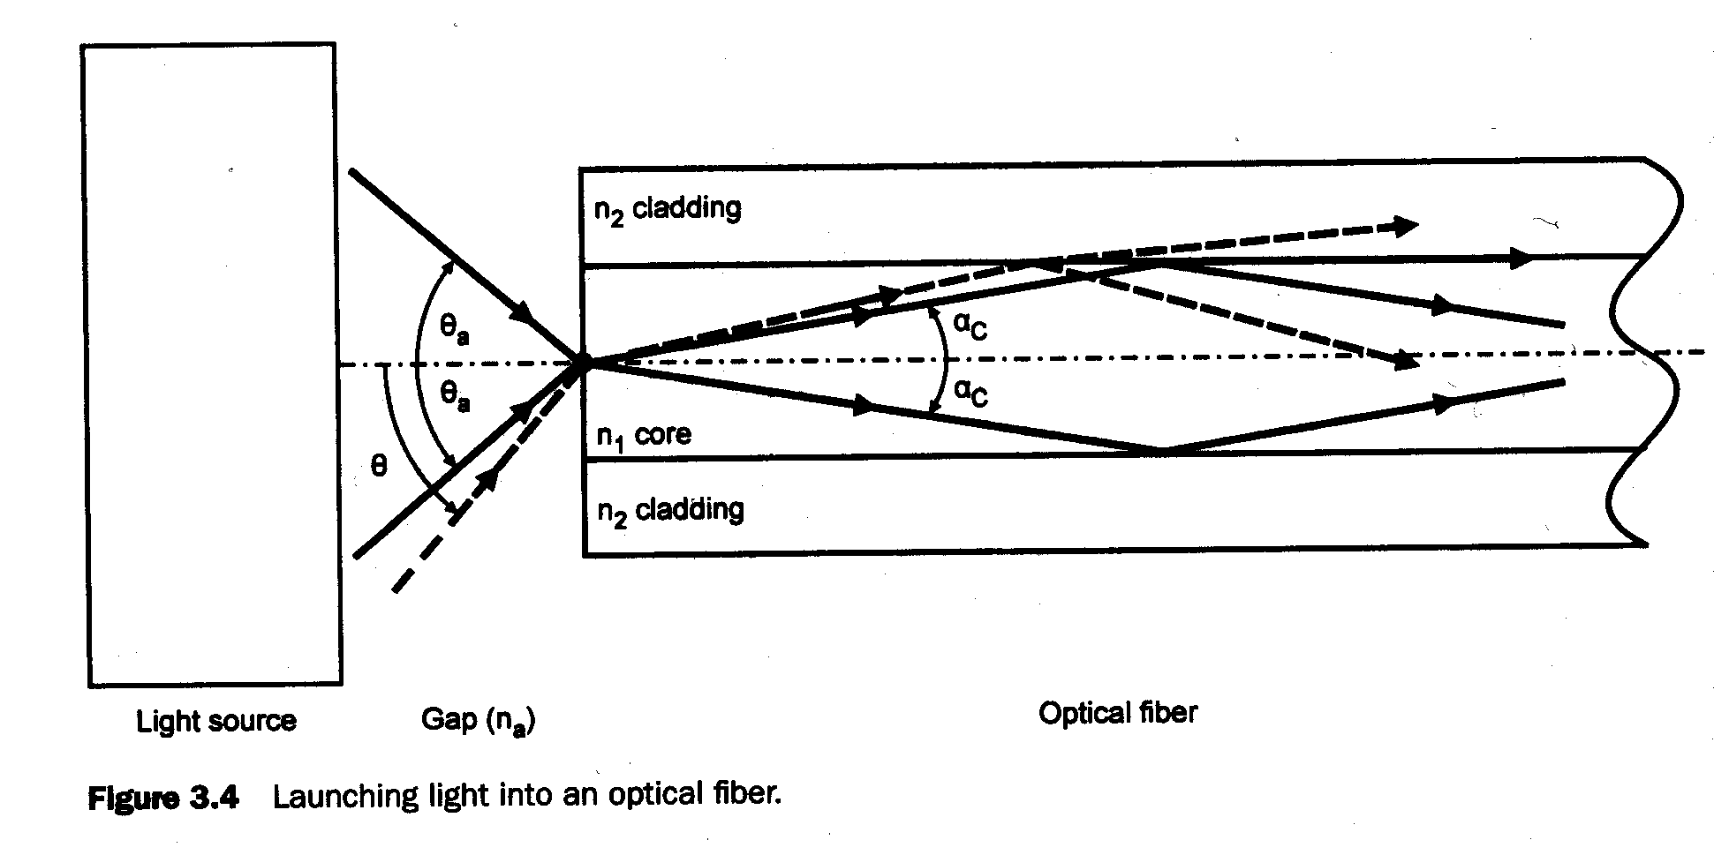
The acceptance angle (θ_{i}) is the largest incident angle ray that can be coupled into a guided ray within the fiber
The Numerical Aperture (NA) is the sin(θ_{i}) this is defined analogously to that for a lens

Slide 13
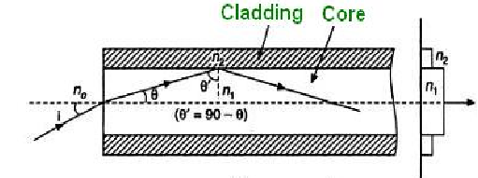
Consider an optical fibre having a core of refractive index n₁ and cladding of refractive index n₂
let the incident light makes an angle i with the core axis as shown in figure .
Then the light gets refracted at an angle θ and fall on the core-cladding interface at an angle where,
By Snell’s law at the point of entrance of light in to the optical fiber we get,

Slide 14

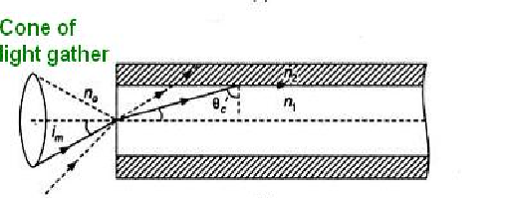
or
When light travels from core to cladding it moves from denser to rarer medium and so it may be totally reflected back to the core medium if θ ‘ exceeds the critical angle θ'_{c}. The critical angle is that angle of incidence in denser medium (n1) for which angle of refraction become 90°. Using Snell’s laws at core cladding interface,
Therefore, for light to be propagated within the core of optical fiber as guided wave, the angle of incidence at core-cladding interface should be greater than θ'_{c}. As i increases, θ increases and so θ' decreases. Therefore, there is maximum value of angle of incidence beyond which, it does not propagate rather it is refracted in to cladding medium . This maximum value of i say i_{m} is called maximum angle of acceptance and n₀ sin i_{m} is termed as the numerical aperture (NA).

Slide 15




Slide 16
Classification of Optical fiber
Classification of Optical Fibers
On the basis of Refractive Index
On the basis of Modes
On the basis of material
Step Indexed Fiber
Graded Indexed Fiber
Single Mode
Multiple Mode
Glass core and glass cladding SCS: Silica-clad silica
Plastic core and cladding
Glass core with plastic cladding PCS (Plastic-Clad Silicon)
Step Indexed Single Mode fiber
Step Indexed Multi Mode fiber
Graded Indexed Multi Mode Fiber

Slide 17
Types Of Modes in Optical Fiber
Light
ray
n₁ core
n₂ cladding
Single-mode step-index Fiber
n₁ core
n₂ cladding
Multimode step-index Fiber
Variable
n
Multimode graded-index Fiber
Index profile

Slide 18
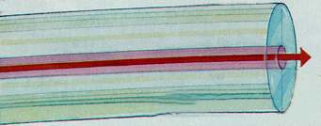
Single mode Fiber
Single mode fiber has a core diameter of 8 to 9 microns, which only allows one light path or mode
Index of refraction
Best for high speeds and long distances
Used by telephone companies

Slide 19
Single mode fibers:
In a fiber, if only one mode is transmitted through it, then it is said to be a single mode fiber.
A typical single mode fiber may have a core radius of 3 μm and a numerical aperture of 0.1 at a wavelength of 0.8 μm.
The condition for the single mode operation is given by the V number of the fiber which is defined as
such that V ≤ 2.405.
Here, n₁ = refractive index of the core; a = radius of the core; λ = wavelength of the light propagating through the fiber; Δ = relative refractive indices difference.

Slide 20
SINGLE MODE FIBER
MULTI MODE FIBER

Slide 21
Multi mode fibers :
If more than one mode is transmitted through optical fiber, then it is said to be a multimode fiber.
The larger core radii of multimode fibers make it easier to launch optical power into the fiber and facilitate the end to end connection of similar powers.
Some of the basic properties of multimode optical fibers are listed below :
More than one path is available
V-number is greater than 2.405
Core diameter is higher
Higher dispersion
Lower bandwidth (50MHz)
Used for short distance communication
Fabrication is less difficult and not costly

Slide 22
Optical fibers based on refractive index profile
Based on Refractive Indexed
Step indexed Optical Fibre
Graded Indexed Optical Fibre
Graded Indexed multimode Optical Fibre
Step indexed Single mode Fibre
Step Indexed Multimode fibre
Based on the refractive index profile of the core and cladding, the optical fibers are classified into two types:

Slide 23
Step index fiber :
In a step index fiber, the refractive index changes in a step fashion, from the centre of the fiber(the core) to the outer shell (the cladding).
It is high in the core and lower in the cladding. The light in the fiber propagates by bouncing back and forth from core-cladding interface.
The step index fibers propagate both single and multimode signals within the fiber core.
The light rays propagating through it in a zig – zag manner.

Slide 24
Step index single mode fibers :
The light energy in a single-mode fiber is concentrated in one mode only.
This is accomplished by reducing (fractional refractive index) Δ and the core diameter to a point where the V-factor is less than 2.4.
In other words, the fiber is designed to have a V number between 0 and 2.4.
This relatively small value means that the fiber radius and Δ, the relative refractive index difference, must be small.
Typically, for a core diameter of 10 μm, the cladding diameter is about 120 μm.
Handling and manufacturing of single mode step index fiber is more difficult.

Slide 25
Step Index single mode
Characteristics
Very small core diameter
Low numerical aperture
Low attenuation
Very High Bandwidth
Very high capacity
Very expensive
Need laser as a source
Application : Sea cable

Slide 26

Step index multimode fibers :
A multimode step index fiber is shown.
In such fibers light propagates in many modes.
The total number of modes M_{N} increases with increase in the numerical aperture.
For a larger number of modes, M_{N} can be approximated by
Multimode fiber has a core diameter of 50 or 62.5 microns (sometimes even larger)
Allows several light paths or modes

Slide 27
where d = diameter of the core of the fiber and
V = V – number or normalized frequency.
The normalized frequency V is a relation among the fiber size, the refractive indices and the wavelength. V is the normalized frequency or simply the V number and is given by
where a is the fiber core radius, λ is the operating wavelength, n1 the core refractive index and Δ the relative refractive index difference.

Slide 28
Contd.
To reduce the dispersion, the N.A should not be decreased beyond a limit for the following reasons:
First, injecting light into fiber with low N.A becomes difficult. Lower N.A means lower acceptance angle, which requires the entering light to have a very shallow angle.
Second, leakage of energy is more likely, and hence losses increase.
The core diameter of the typical multimode fiber varies between 50 μm and about 200 μm, with cladding thickness typically equal to the core radius.

Slide 29
Step index multimode (50-200 / 100-250)
Characteristics
High core diameter
Large core size, so source power can be efficiently coupled to the fiber
High numerical aperture
High attenuation (4-6 dB / km)
Low bandwidth (50 MHz-km)
Less expensive
LED light source
Used in short, low-speed datalinks
Also useful in high-radiation environments, because it can be made with pure silica core

Slide 30
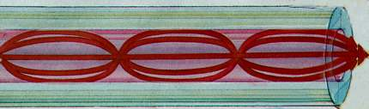
Multimode Graded-Index Fiber
The index of refraction gradually changes across the core
Modes that travel further also move faster
This reduces modal dispersion so the bandwidth is greatly increased
Index of refraction

Slide 31
Graded Indexed Multimode fiber

Slide 32
Graded index fibers :
In graded index fiber the refractive index n in the core varies as we move away from the center.
The refractive index of the core is made to vary in the form of parabolic manner such that the maximum refractive index is present at the centre of the core.
The light rays will be propagated in the form skew rays (or) helical rays which will not cross the fiber axis at any time and are propagating around the fiber axis in a helical or spiral manner.
The effective acceptance angle of the graded-index fiber is somewhat less than that of an equivalent step-index fiber. This makes coupling fiber to the light source more difficult.
The number of modes in a graded-index fiber is about half that in a similar step-index fiber.
The lower the number of modes in the graded-index fiber results in lower dispersion than is found in the step-index fiber.
The size of the graded-index fiber is about the same as the step-index fiber. The manufacture of graded-index fiber is more complex. It is more difficult to control the refractive index well enough to produce accurately the variations needed for the desired index profile.

Slide 33
Graded index multimode (50-200 /100-250)
Characteristics
High core diameter
62.5/125 micron has been most widely used
Works well with LEDs, but cannot be used for Gigabit Ethernet
50/125 micron fiber and VSELS are used for faster networks
Small numerical aperture
Low attenuation
Intermediate bandwidth
Most expensive
Laser / LED
Useful for “premises networks” like LANs, security systems, etc

Slide 34
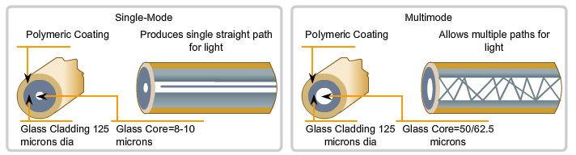
Single mode vs. Multimode Fibers
Single-Mode | Multimode
Small core Less dispersion Carry a single ray of light, usually generated from a laser. Employ for long distance applications (100Km) Uses as Backbone and distances of several thousands meters. | Larger core than single mode cable. Allows greater dispersion and therefore, loss of signal. Used for shorter distance application, but shorter than single-mode (up to 2Km) It uses LED source that generates differtes angles along cable. Often uses in LANs or small distances such as campus networks.

Slide 35
Single-mode step-index Fiber
Advantages:
Minimum dispersion: all rays take same path, same time to travel down the cable. A pulse can be reproduced at the receiver very accurately.
Less attenuation, can run over longer distance without repeaters.
Larger bandwidth and higher information rate
Disadvantages:
Difficult to couple light in and out of the tiny core
Highly directive light source (laser) is required
Interfacing modules are more expensive

Slide 36
Multi Mode
Multimode step-index Fibers:
inexpensive
easy to couple light into Fiber
result in higher signal distortion
lower TX rate
Multimode graded-index Fiber:
intermediate between the other two types of Fibers

Slide 37
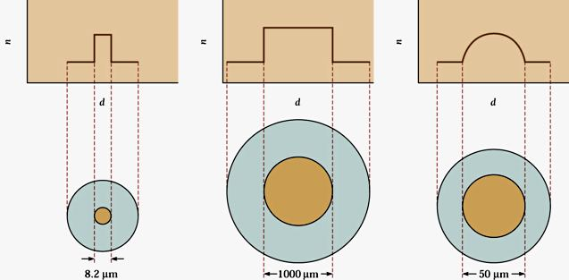
In Step-index fibers index of refraction changes radically between the core and the cladding
Graded-index fiber is a compromise multimode fiber, but the index of refraction gradually decreases away from the center of the core
Graded-index fiber has less dispersion than a multimode step-index fiber

Slide 38
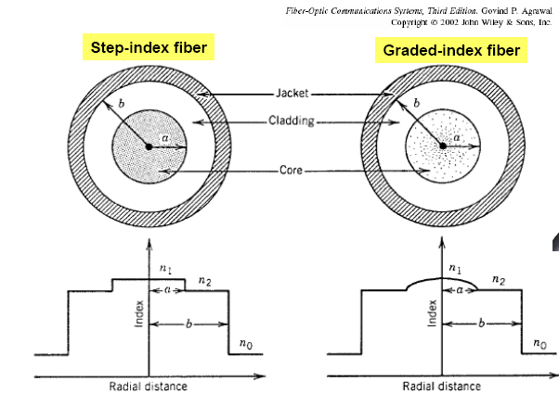

Slide 39
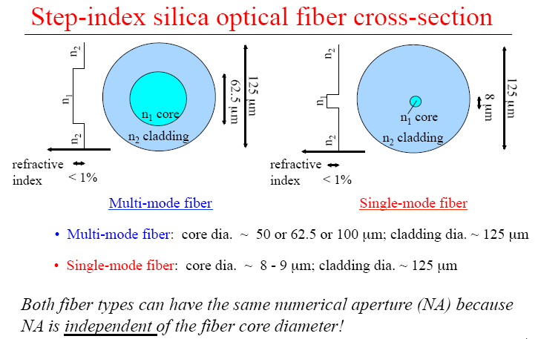

Slide 40
Fiber modes --- single mode and multi-mode fibers
V-number
An index value V, defined as the normalized frequency is used to determines how many different guided modes a fiber can support.
Number of modes when V>>2.41
Normalized propagation constant
for V between 1.5 – 2.5.
Mode field diameter (MFD)

Slide 41
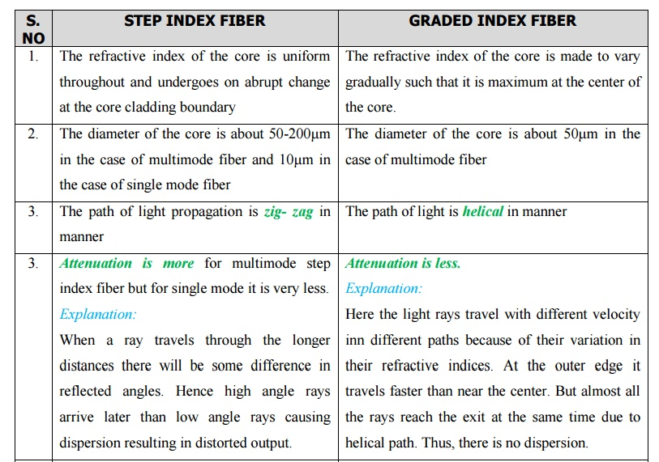
Difference between Step Index fiber and Graded Index fiber

Slide 42
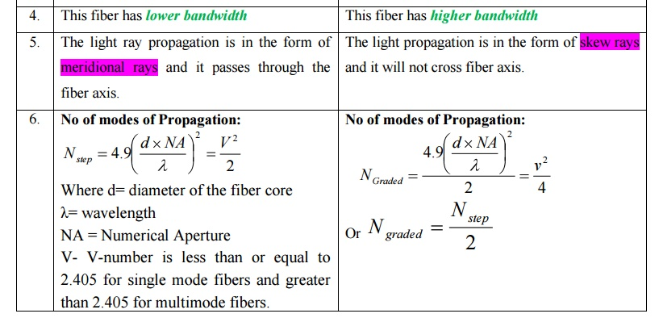

Slide 43
Fiber Optic Specifications
Attenuation
Loss of signal, measured in dB
Dispersion
Blurring of a signal, affects bandwidth
Bandwidth
The number of bits per second that can be sent through a data link
Numerical Aperture
Measures the largest angle of light that can be accepted into the core

Slide 44
Application of Optical Fiber
Telecommunications
Local Area Networks
Cable TV
CCTV
Optical Fiber Sensors
Medical - Endoscope
Used as light guides, imaging tools and also as lasers for surgeries
Defense/Government
Used as hydrophones for seismic waves and SONAR , as wiring in aircraft, submarines and other
Data Storage
Used for data transmission
Telecommunications
Fiber is laid and used for transmitting and receiving purposes
Networking
Used to connect users and servers in a variety of network settings and help increase the speed and accuracy of data transmission
Industrial/Commercial
Used for imaging in hard to reach areas, as wiring where EMI is an issue, as sensory devices to make temperature, pressure and other measurements, and as wiring in automobiles and in industrial settings
Broadcast/CATV
Broadcast/cable companies are using fiber optic cables for wiring CATV, HDTV, internet, video on-demand and other applications

Slide 45
Numerical Questions
Calculate the numerical aperture and acceptance angle of an optical fibre.
Given n1 =1.55, n2 = 1.50
A fibre cable has an acceptance angle of 30⁰ and a core index of refraction of 1.4. Calculate the refractive index of the cladding.
Calculate the refractive indices of the core and cladding material of a fibre from following data. Numerical aperture = 0.22 and fractional difference of indices = 0.122.
In an optical fiber, the core material has R.I 1.43 and R.I of clad material is 1.4. Find the propagation angle.

